Slide 1
Encoders
Abu Humayed Azim Fahmid
Lecturer, CSE Dept., UIU

Slide 2
Encoders
Does reverse operation to decoder
An encoder has 2^{n} (or fewer) input lines and n output lines
Constraint – only one input is active at a time

Slide 3
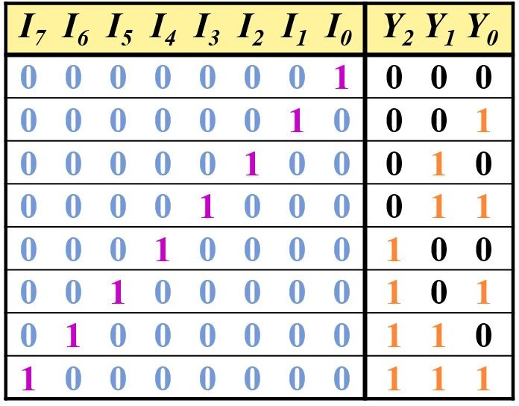
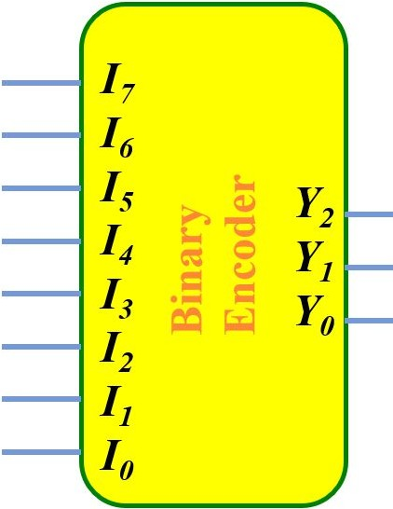
Octal-to-Binary Encoder (8-to-3)

Slide 4
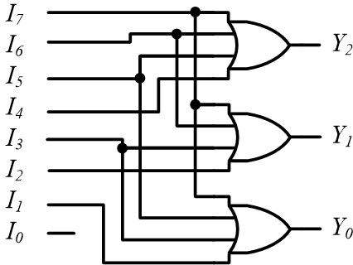
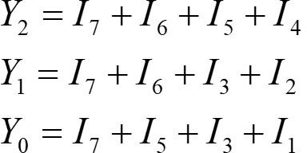
Octal-to-Binary Encoder (8-to-3)

Slide 5
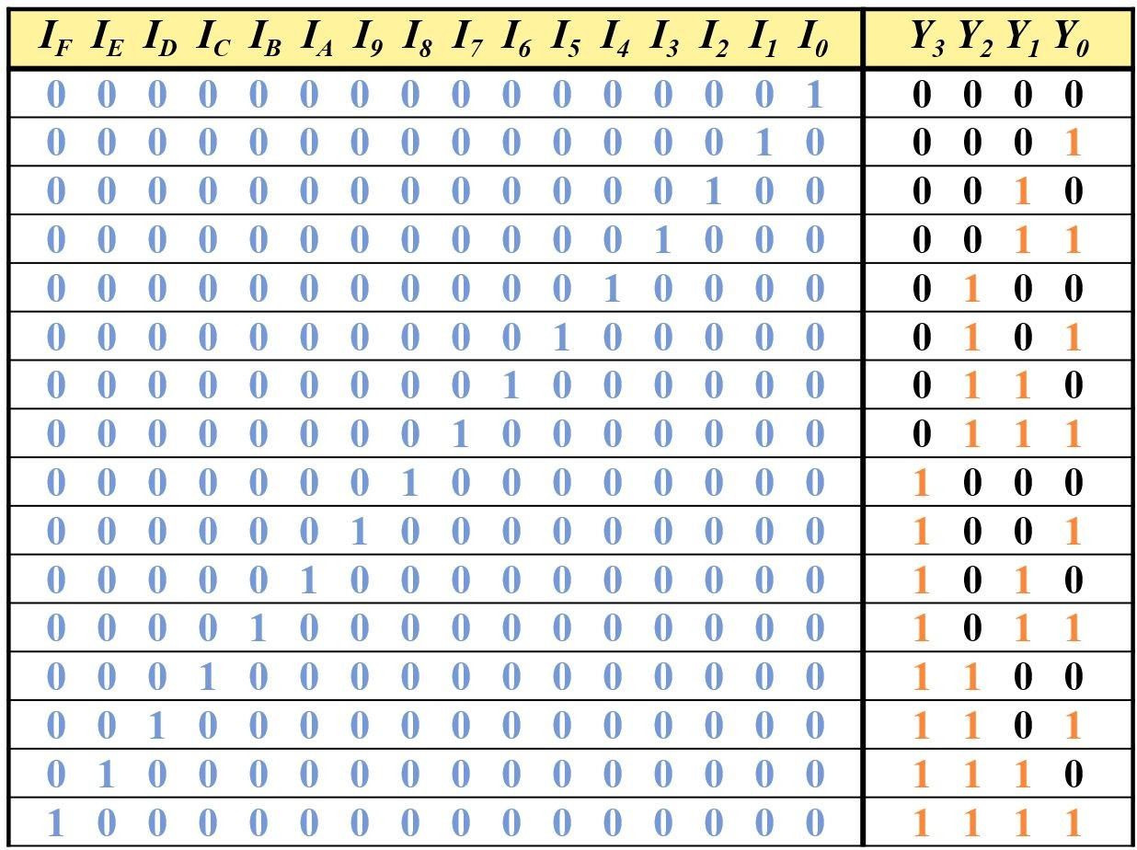
Hexadecimal-to-Binary Encoder (16-to-4)

Slide 6
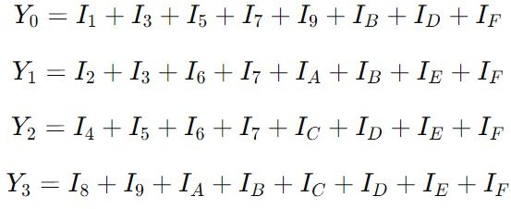
Hexadecimal-to-Binary Encoder (16-to-4)

Slide 7
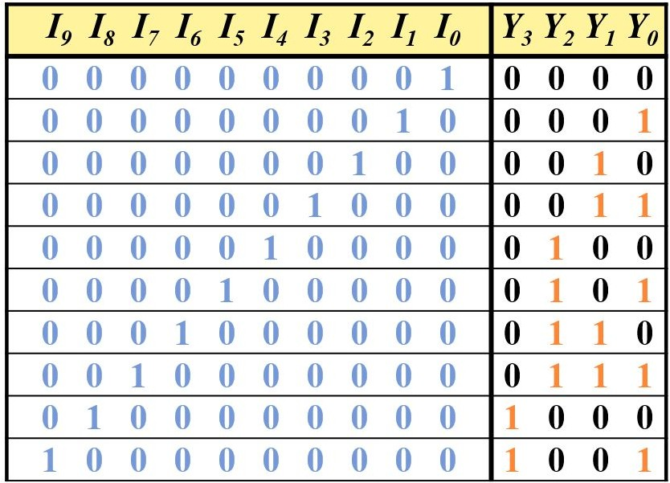
Decimal-to-BCD Encoder (10-to-4)

Slide 8



Decimal-to-BCD Encoder (10-to-4)

Slide 9
Priority Encoder
Encoder with priority function
Multiple inputs may be true simultaneously
Higher priority input gets the precedence

Slide 10
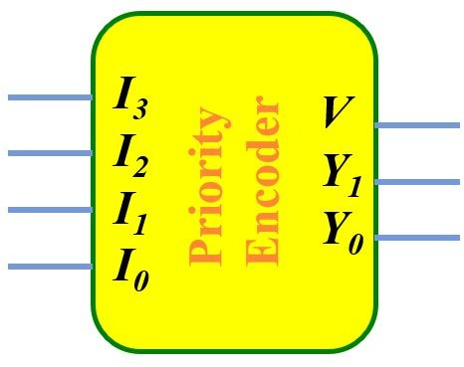
4-Input Priority Encoder

Slide 11
4-Input Priority Encoder
First let us set the Priority

Slide 12
4-Input Priority Encoder
First let us set the Priority
Highest Priority
Lowest Priority

Slide 13
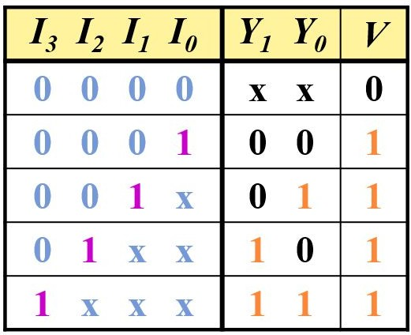
4-Input Priority Encoder

Slide 14
4-Input Priority Encoder
Here, V is the valid bit
It indicates whether or not there is at least one high-priority input present (i.e., any of the inputs I₀, I₁, I₂ or I₃ is 1).

Slide 15
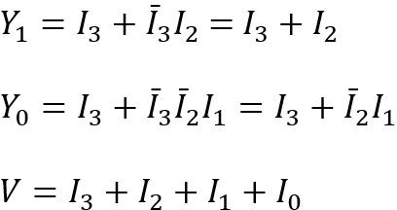
4-Input Priority Encoder

Slide 16
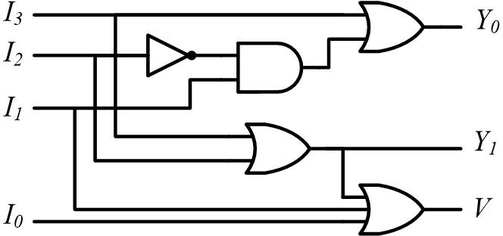
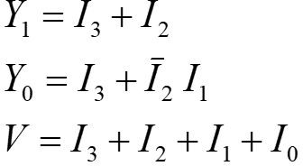
4-Input Priority Encoder

Slide 17
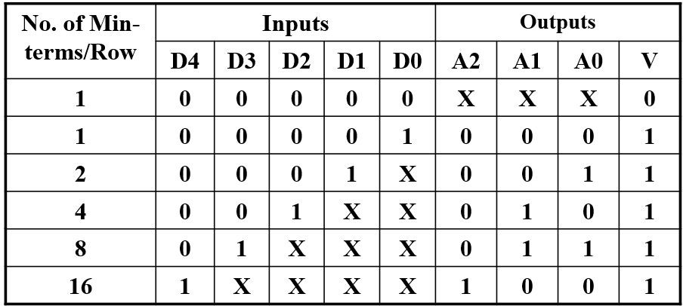
5-Input Priority Encoder
Now, let’s try to ﬁnd equations for a 5-Input Priority Encoder.

Slide 18
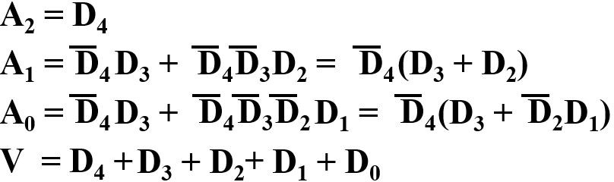
5-Input Priority Encoder

Slide 19
8-Input Priority Encoder
Now, how about 8-Input Priority Encoder with priority: D₇>D₆>D₅>D₄>D₃>D₂>D₁>D₀
Can you make the truth table and the equations?
Try it yourself
You can avoid the valid bit if you want for this problem

Slide 20
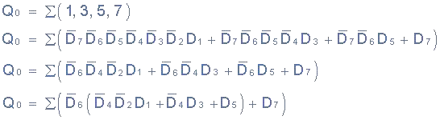
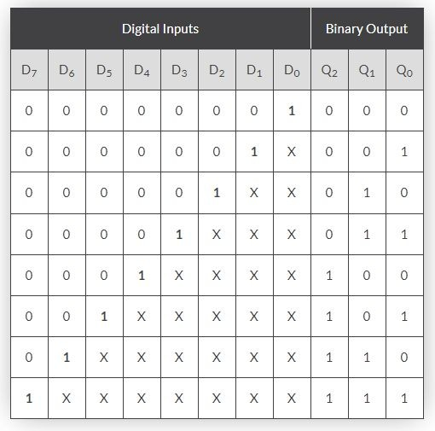
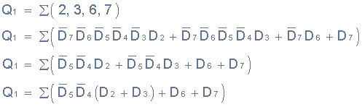
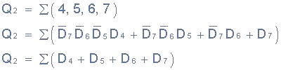
8-Input Priority Encoder
Solution:

Slide 21
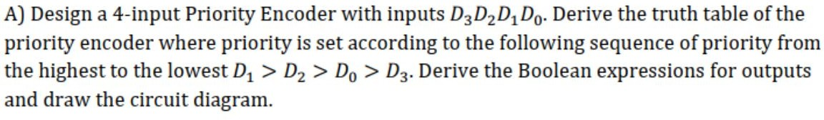
Priority Order Can be Different in Problems
For example, let’s try to solve this problem.

Slide 22
Priority Order Can be Different in Problems
Solution:
D₃ D₂ D₁ D₀ |  |  |  | Y₁ Y₀ |  | V
0 | 0 | 0 | 0 | x | x | 0
 |  |  |  | 0 | 0 | 1
 |  |  |  | 0 | 1 | 1
 |  |  |  | 1 | 0 | 1
 |  |  |  | 1 | 1 | 1

Slide 23
Priority Order Can be Different in Problems
Solution:
D₃ D₂ D₁ D₀ |  |  |  | Y₁ Y₀ |  | V
0 | 0 | 0 | 0 | x | x | 0
 |  |  |  | 0 | 0 | 1
x x 1 x |  |  |  | 0 | 1 | 1
 |  |  |  | 1 | 0 | 1
 |  |  |  | 1 | 1 | 1

Slide 24
Priority Order Can be Different in Problems
Solution:
D₃ D₂ D₁ D₀ |  |  |  | Y₁ Y₀ |  | V
0 | 0 | 0 | 0 | x | x | 0
 |  |  |  | 0 | 0 | 1
x x 1 x |  |  |  | 0 | 1 | 1
x 1 0 x |  |  |  | 1 | 0 | 1
 |  |  |  | 1 | 1 | 1

Slide 25
Priority Order Can be Different in Problems
Solution:
D₃ D₂ D₁ D₀ |  |  |  | Y₁ Y₀ |  | V
0 | 0 | 0 | 0 | x | x | 0
x 0 0 1 |  |  |  | 0 | 0 | 1
x x 1 x |  |  |  | 0 | 1 | 1
x 1 0 x |  |  |  | 1 | 0 | 1
 |  |  |  | 1 | 1 | 1

Slide 26
Priority Order Can be Different in Problems
Solution:
D₃ D₂ D₁ D₀ |  |  | Y₁ Y₀ |  | V
0 0 | 0 | 0 | x | x | 0
x 0 | 0 | 1 | 0 | 0 | 1
x x | 1 | x | 0 | 1 | 1
x 1 | 0 | x | 1 | 0 | 1
1 0 | 0 | 0 | 1 | 1 | 1

Slide 27
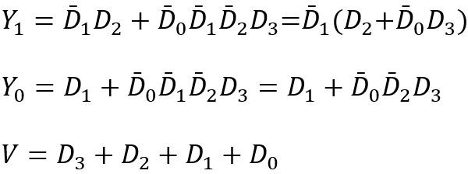
Priority Order Can be Different in Problems
Solution:
D₃ D₂ D₁ D₀ |  |  | Y₁ Y₀ |  | V
0 0 | 0 | 0 | x | x | 0
x 0 | 0 | 1 | 0 | 0 | 1
x x | 1 | x | 0 | 1 | 1
x 1 | 0 | x | 1 | 0 | 1
1 0 | 0 | 0 | 1 | 1 | 1

Slide 28
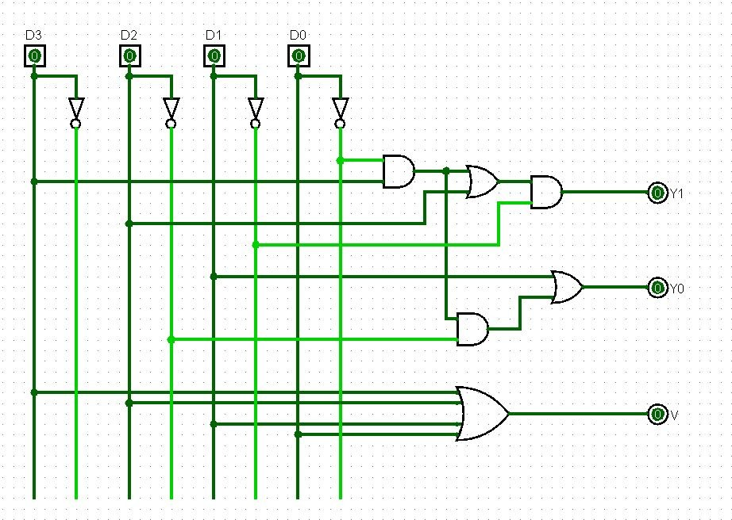
Priority Order Can be Different in Problems
Solution:

Slide 29

Practice more!!
Check book exercises and previous ﬁnal questions

Slide 30


